Slide 1
Rotary endodontics
MDDr.Radovan Žižka

Slide 2
Aim of seminary
Basic information about Ni-Ti alloy
Dividing NiTi rotary instruments
Tip configuration
Cross-sectional design
Flute design
Rake angle
Taper
Principles o NiTi instruments
Fracture prevention of NiTi instruments
Techniques used with NiTi files

Slide 3
NiTi alloy
1963 – developed for space program by Buehler at Naval Ordonance Laboratory
in Silver Springs, Maryland, USA
Very low elastic modulus (permit negotiation of curved canals)
Superelastic behavior
Shape memory

Slide 4
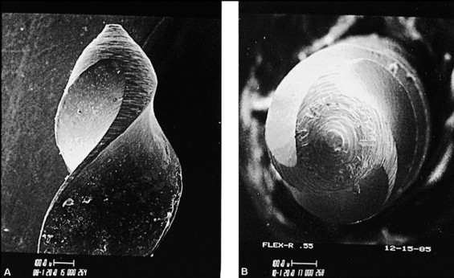
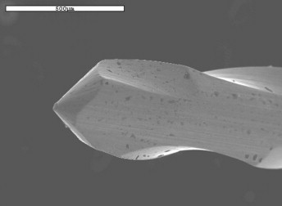
Tip configuration
Cutting
Transportation of canal in less experienced hands
Making apical seal and obturation difficult
Going long with it, creates an elliptical tear at the end of the root
Non cutting
Reduces the risk of ledging,scratching or gouging
Making apical seal and obturation easier
Going long with it, creates concentric circle at the end of the root

Slide 5
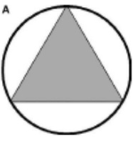
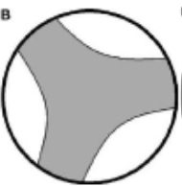
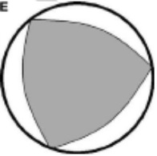
Cross sectional design
Triangular
Square
U shape
S type
Convex triangle
Proprietary ones

Slide 6
Flute design part 1
Landed flute design(with radial lands)
Cutting edges had been flattened (named radial lands), U-file design
Instruments have to be pushed with light pressure to engage the perimeter of the canal and then cut the dentin there
Make preparation slower but safer
Increase strenght and decrease flexibility
Good centering of instrument, preventing binding or screwing to dentin
Radial land
U shape

Slide 7
Flute design part 2
Non-landed flute design
Sharp cutting edges resulting from a traingular cross sectional design that cuts more rapidly but can lead also to preparation errors
Consider more efficient but require more operator skill to avoid procedural mishap compared to radial-landed files
More flexible
Others
Sharp cutting edge

Slide 8
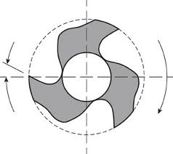
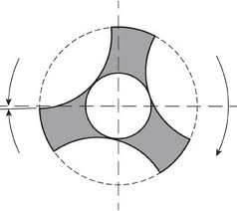
Rake angle
Is the angle formed by the cutting edge and a cross section taken perpendicular to the long axis of the instrument
Possitive rake angle
Shave dentin
Negative rake angle
Scrape dentin
Neutral rake angle
Plan dentin

Slide 9
Principles of NiTi part 1
Not use as pathfinder
Should not be used to negotiate small calcified canals or curved canals because of its non cutting tip
Should not be used to bypass ledges
Should not be applied with pressure
Should not be used for estimating working lenght (stainless steel instruments are more opaque)

Slide 10
Principles of NiTi part 2
Need more flaring of access to decrease fatigue of file
Must be used in a lubricated canal to reduce frictional resistance
Should not be used in abrupt curves, S-shapes and canals that join
Once the instrument starts to wobble in the handpiece, the file should be disposed off

Slide 11
Principles of NiTi part 3
When NiTi experiences any undue stress including cyclic fatigue, the metal undergoes a crystalline (microscopic) phase transformation and become structurally weaker
Cutting efficiency decreases with repeated sterilization(prone to fracture)
NiTi file may disarticulate without any warning especially if not properly used
Each instrument should not be used more than 5-10 secunds only

Slide 12
Fracture prevention of NiTi rotary instruments part 1
Use only torque controlled handpiece
Establishing of proper glidepath
Use of crown-down technique
Frequent cleaning of flutes
Do not force the file apically against resistance
Remove the maximum possible pulp tissue with broach before using rotary files

Slide 13
Fracture prevention of NiTi rotary instruments part 2
Canals should be well lubricated (no dentin mud which increase the risk of fracture)
Discard the file if it is bent, stretched, has shiny spots or wobbles in handpiece
Do not use rotary files to true working lenght especially in teeth with S-shaped canals, sharp curves
Frequently inspect file flutes under magnification

Slide 14
Types of rotary instruments according to tapering
Tapered
Constant - the diameter increases in a constant manner (Profile)
Progressive - the diameter increases in a progressive manner (ProTaper)
Variable - whether increaes in a variable manner (S1,S2) or increases then decrease (SX, finishing files)
Non-tapered

Slide 15
Techniques that might be used for rotary instrumentation
Crown-down pressureless method
Modified crown down method
Graduating taper method
Starting with smaller tapered instruments, where each instrument is taken to the full working lenght and then proceeding with larger tapers (tip size is constant)
Step-back method
Modified step-back method
Use of Lightspeed system

Slide 16
ProTaper
Is one of widely used NiTi system today
Innovations which characterize ProTaper:
Progressive/variable taper
Modified guiding tip(rounded, non-cutting and parabolic shaped tip)
Varying tip diameters
Convex triangular cross-section (not all of them)
A positive rake angle
Shorter handle of the file
Work longer in superelastic phace than do instruments with U-file design

Slide 17
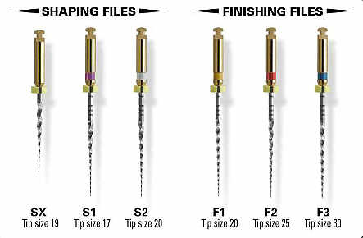
ProTaper instruments
3 shaping and 3 finishing files (and 2 additional finishing files)
Shaping
SX,S1,S2
Finishing
F1,F2,F3
F4,F5
http://www.dentsply.com

Slide 18
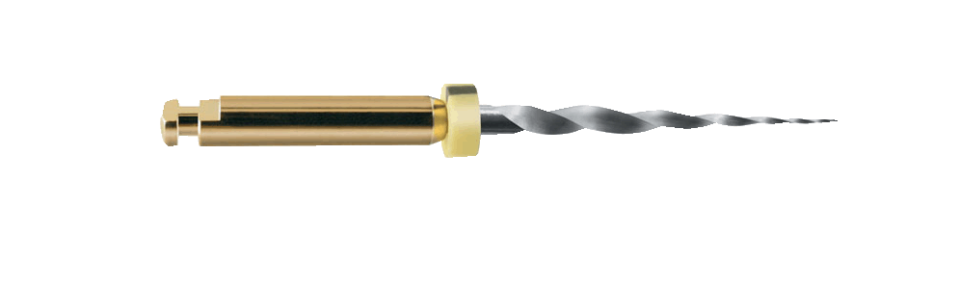
ProTaper SX
SX File (auxiliary shaping file)
Tip size – ISO19
Taper -D0-D9 – from ISO 19-ISO 100
-D9-D14 – from ISO100-ISO120 (reduction in taper to increase flexibility)
Color code – none
Designed to
Coronal flaring
Relocate the canal away from the external root concavities
http://www.dentsply.com

Slide 19
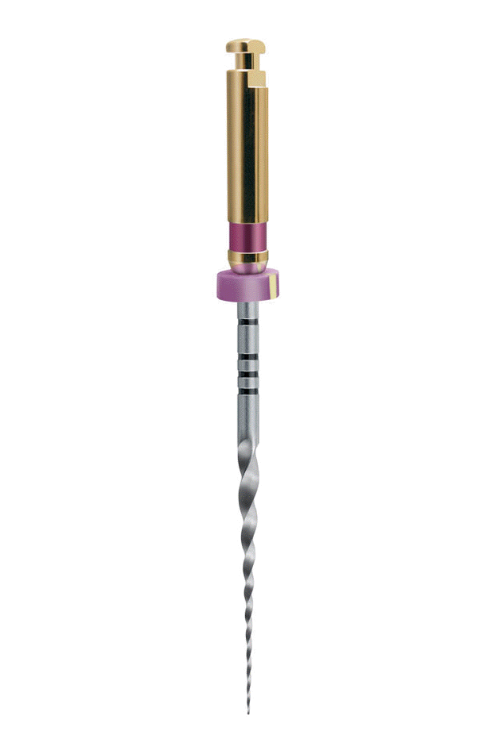
ProTaper S1
S1 File
Tip size – ISO18,5
Taper - D0-D14 –
from ISO 18,5-ISO 120
(Increasibly larger taper)
Color code – purple
Designed to
Preparation coronal 1/3 of root canal
http://www.dentsply.com

Slide 20
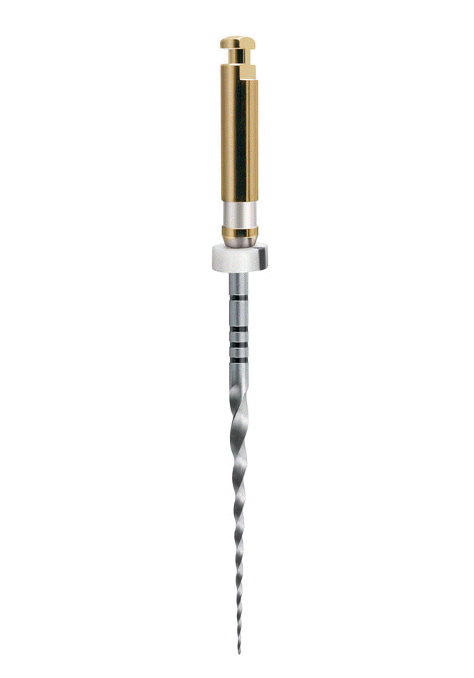
ProTaper S2
S2 File
Tip size – ISO20
Taper - D0-D14 – from ISO 20-ISO 110
(Increasibly larger taper)
Color code – white
Designed to
Enlarge and prepare the middle 1/3 in addition to the critical coronal region of the apical 1/3
http://www.dentsply.com

Slide 21
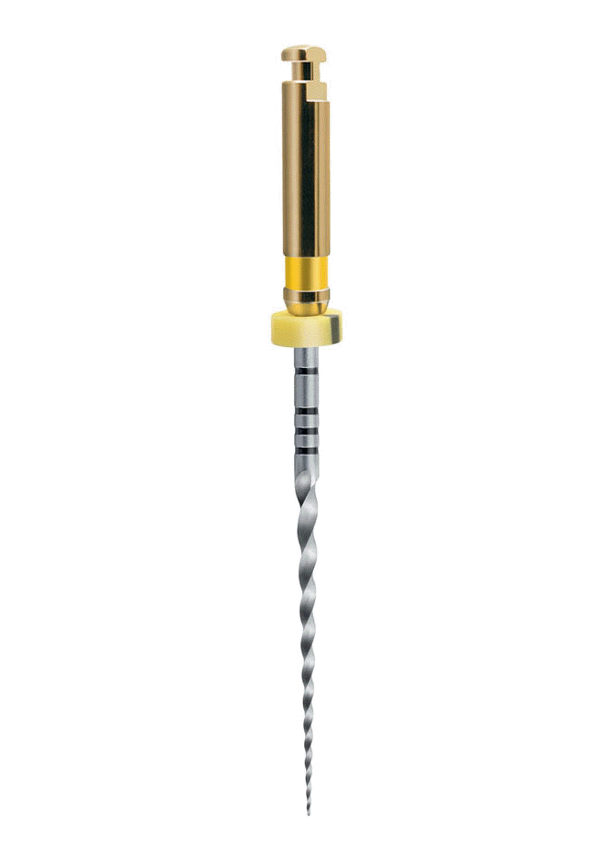
ProTaper F1
F1 File
Tip size – ISO20
Taper - D0-D3 – 7° taper
- D3-D14 – a reduction in taper to increase flexibility
Color code – yellow
Designed to
Primarily to finish apical 1/3 of the canal
Expand the middle 1/3 of the canal
Plane away the variations in canal diameter after shaping
http://www.dentsply.com

Slide 22
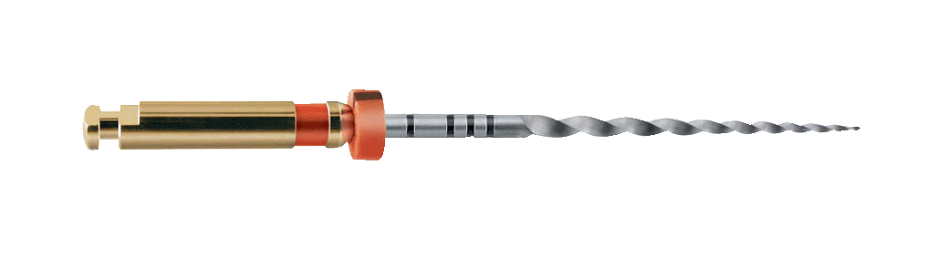
ProTaper F2
F2 File
Tip size – ISO25
Taper - D0-D3 – 8° taper
- D3-D14 – a reduction in taper to increase flexibility
Color code – red
Designed to
Primarily to finish apical 1/3 of the canal
Expand the middle 1/3 of the canal
Plane away the variations in canal diameter after shaping
http://www.dentsply.com

Slide 23
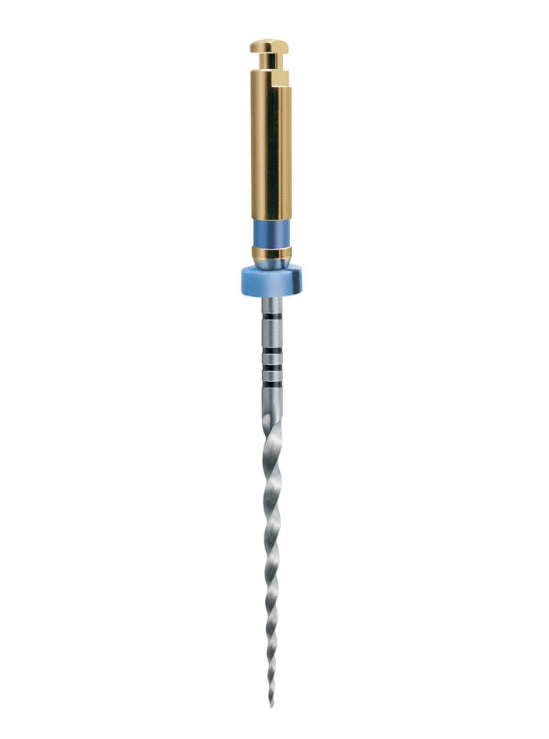
ProTaper F3
F3 File
Tip size – ISO30
Taper - D0-D3 – 9° taper
- D3-D14 – a reduction in taper to increase flexibility
Color code – blue
Reduced cross-section with U-file design
Designed to
Same as F1 and F2
Rigid and agressive
http://www.dentsply.com

Slide 24
ProTaper
In addition there are F4 (double black, ISO40, initial taper is 6°) and F5 (double yellow, ISO50,initial taper is 5°)
Shaping instruments should be used in brushing motion, finishing with just light pressure
After each instrument irrigation,establishing patency and reirrigation

Slide 25
ProTaper technique
Scout coronal 2/3 with K-file ISO 10, ISO 15 (coronal glidepath)
Shaping coronal 2/3 with S1,S2
Scout apical 1/3 with K-file ISO 10, ISO 15 – establishing working lenght (apical glidepath)
Finishing apical 1/3 with S1,S2,F1….

Slide 26
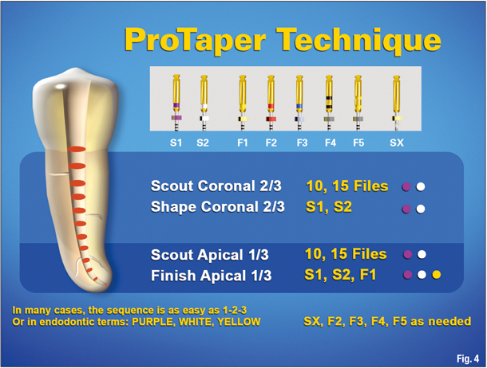
http://www.dentsply.com

Slide 27
Advantages of ProTaper part 1
Patented progressive taper design
Fewer files are needed to achieve fully tapered canal
Convex triangular section
Increase the cutting efficiency
Increase tactile sensation
Decrease the lateral contact area between file and dentin
Decrease torsional load, file fatigue and breakage

Slide 28
Advantages of ProTaper part 2
The modified guiding tip can easily follow a prepared glidepath
A progressively changing helical angles and balanced pitches
Stabilizing each instrument
Aiding in debris removal
Effectively reducing threading (screwing, grabbing and taper lock)

Slide 29
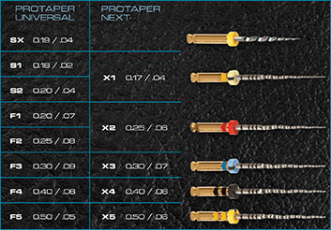
ProTaper Next
http://www.dentsply.com

