Slide 1
TECHNIQUES AND METHODS OF PREPARATION OF ROOT CANALS
MDDr. Radovan Žižka

Slide 2
AIM OF SEMINARY
Aim of endodontic treatment
Shaping and cleaning
Schilder (1974)
Contemporary aproach
Concepts which are used during root canal preparation
Techniques and methods of preparation of root canals

Slide 3
AIM OF ENDODONTIC TREATMENT
Aim of endodontic treatment is desinfiction of root canal, which is followed by hermetic obturation

Slide 4
SHAPING AND CLEANING
Shaping –the purpose is to prepare a shape of root canal which respects original anatomy and makes possible thorought cleaning and hermetic obturation
Cleaning – the purpose is to remove all the material in root canal (pulp, preparation debris, microorganisms)

Slide 5
SHAPING AND CLEANING (Schilder,1974)
Shaping
Mechanical aims
Biological aims
Cleaning
Exstirpation
Dissolving material of biological origin
Removing preparation debris

Slide 6
SHAPING AND CLEANING (contemporary aproach)
Kompletní přístup
Direct view on the whole pulp chamber floor and its morphology (root canal orifices)
Straight line access
Continuously narrowing preparation
Allows irrigation and removing of debris
Allows hermetic obturation

Slide 7
SHAPING AND CLEANING (contemporary aproach)
Respecting original anatomy
Shape of root canal preparation respects and follow original anatomy
Protecting healthy teeth structures
Increase resistance against fracture
Decrease probability of perforation
Apical preparation should be as small as it is possible to procede adequate cleaning

Slide 8
CONCEPTS USED DURING PREPARATION
Straight line access (SLA)
Coronal flaring
Working lenght (WL)
Apical width (AW)
Patency
Recapitulation
Glidepath

Slide 9
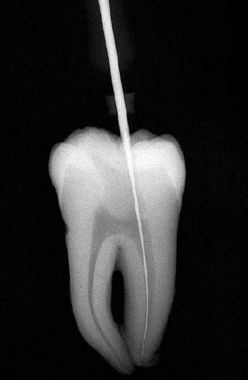
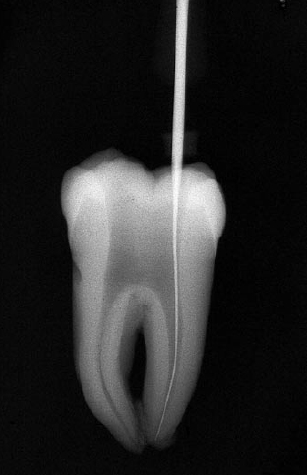
STRAIGHT LINE ACCESS
Ideally should working instrument reach foramen fysiologicum (or first curvature) without bending.
Influenced by:
Shape of access cavity
Coronal flaring

Slide 10
CORONAL FLARING
Before we reach working lenght with ours instrument we should procede coronal flaring
Remove the most infected tissue in root canal
Create reservoir for irigation sollution
Allows straight line access

Slide 11
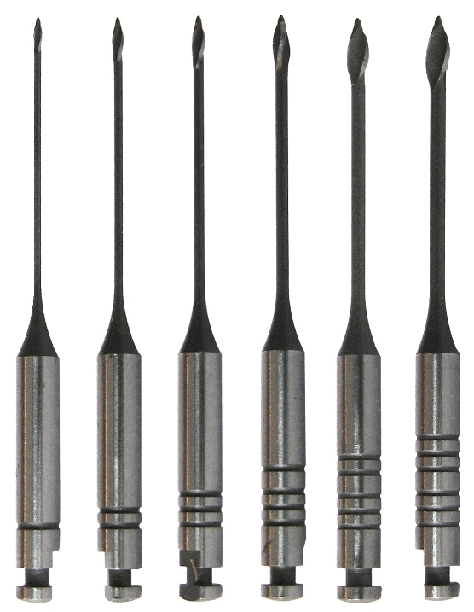
CORONAL FLARING
Gates-Glidden
Rotatory endodontic files
ProTaper SX
ProFile orifice shapers
Zdroje:
http://www.dentalcapitalbh.com.br/media/endodontia-maillefer/PROFILE-ORIFICE-SHAPER.jpg
http://t2.gstatic.com/images?q=tbn:ANd9GcRFzd64ffFlSVlBgqLeRkas-DSIzpjvIoBZFrX5AWN41mk1WcewZw
http://t2.gstatic.com/images?q=tbn:ANd9GcQ1pep7_AoQOTj-39l2cmMbqLtdv-GFWtwTb8lpgIgPjW0YnYD4

Slide 12
WORKING LENGHT
Lenght of working instrument from reference point to foramen fysiologicum (boundary between cement and dentin)
Foramen fysiologicum
Dentin
Cement
Pulp tissue

Slide 13
WORKING LENGHT
We can find it out
Average values – very unprecise. Can be used only as safe lenght
Radiologically – unprecise. Fysiological foramen is usually about 1-1,5 mm from anatomical apex
Electronically– electronic apex locator (EAL) are based on pricipal that resistance between oral mucosa and periodontal ligaments is constant

Slide 14
APICAL WIDTH
Depends on original diameter and shape of root canal, used taper of instrume and diagnosis
High taper
Less infected root canals
Small diameter(incisors, calcification)
Unpleasant root canal anatomy
Low taper
Badly infected root canal
Root canal retreatment
Bigger diameter(young patiens, palatal root of M1)

Slide 15
PATENCY
Keeping apical foramen free of debris by using patency file (usually K-file size #10 or #15) that is passively extended just through apical foramen
Helps to maintain working lenght
Helps to removing preparation debris
Foramen fysiologicum
Patency file
Foramen apicale

Slide 16
RECAPITULATION
Checking the working lenght with the working instruments with a 1ISO smaller diameter than working instrument we have used before
Helps to maintain working lenght
Helps to remove preparation debris

Slide 17
GLIDEPATH
Using of (usually) stainless steel files before Ni-Ti rotarory files
Producing smooth reproducible glide path for rotatory instruments
Preparation at least to ISO 15(allows removing preparation debris)
Checking straight line access
Valuable information abou root canal anatomy

Slide 18
TECHNIQUES AND METHODS OF ROOT CANAL PREPARATION
Technique – instrumentation with one file
Method – instrumentation sequence (can obtain more techniques)
We divide to hand, rotatory,hybrid (following are hand ones)

Slide 19
TECHNIQUES OF ROOT CANAL PREPARATION
Standarized (watch-winding)
Reaming
Filing
Balanced force

Slide 20
STANDARDIZED TECHNIQUE
Indication
Initial probing of root canal
Recapitulation
Retreatment
Complication
Extrusion of preparation debris beyond apex
Ledge
Instruments
K-reamer, K-file

Slide 21
STANDARDIZED TECHNIQUE
Instrument is pushing apically during rotating in clock-wise and anti clock-wise direction (about 45°)
15
15

Slide 22
REAMING TECHNIQUE
Indication
Straight root canals of circular diameter
Complication
Straightening of root canals
Zip-elbow
Instruments
K-reamer (rotation 45°)
K-file (rotation less than 45°)

Slide 23
REAMING TECHNIQUE
We pass instrument passivelly to root canal and then we rotate it around 45° with small presure.Then we take the instrument out.
15

Slide 24
FILING TECHNIQUE
Indication
Oval shape root canals
Retreatment
Smoothing the preparation
Complication
Extruding debris through apex
Instrument
H-file

Slide 25
FILING TECHNQUE
We insert instrument passivelly and then pull it up 2-3mm agains root canal wall. It´s neccesary to irigate very often and equal preparation of walls.
15

Slide 26
BALANCED FORCE TECHNIQUE
Indication
Complicated root canal anatomy
The most universal technique for glidepath
Complication
Straightening of root canal
Instrument
K-flexofile (Flex-R file)
K-file

Slide 27
BALANCED FORCE TECHNIQUE STEP 1
Insert instrument passively which has 1ISO diameter larger than current master apical file.
15

Slide 28
BALANCED FORCE TECHNIQUE STEP 2
With small pressure we rotate instrument around 90° in the clock-wise direction. Instrument will engage dentin of the root canal wall.
15

Slide 29
BALANCED FORCE TECHNIQUE STEP 3
With minimal pressure we rotate instrument around 180-270° counter clockwise direction. Pressure should maintain instrument at or near the clockwise insertion depth. It will break loose the engaged dentin chips from root canal wall.
15

Slide 30
BALANCED FORCE TECHNIQUE STEP 4
The file si then removed from root canal by a slow clockwise rotation around 360° that loads debris into the flutes and elevates is away.
15

Slide 31
BALANCED FORCE TECHNIQUE STEP 4
Because we don´t use prebend files the straightening of root canal can occur. If root canal is complicated we suggest instead of step 4 go on with step 1 until the working lenght is reached. (ledge and breakage are more probable)

Slide 32
METHODS OF ROOT CANAL PREPARATION
Apicocoronal – we prepara from begging with complete working lenght or we shorten it.
Combined (reaming-filing)
Step-back
Coronoapical – we prepare with shortened working lenght which is further prolonged.
Step-down
Double flared
Crowndown presureless

Slide 33
COMBINED METHOD
Indication
Straight canals (oval)
Recreation of apical stop after overinstrumentation of apex
Complication
Zip-elbow, perforation (in case of curvature in apical part of root canal)
Instruments
Changing of K-file and H-file

Slide 34
COMBINED METHOD
By K-file we prepare with balanced force technique up to working lenght
Then passively insert H-file and with filing technique we prepare root canal
We repeat whole procedure with files 1 ISO larger.
15
15
20
20

Slide 35
STEP-BACK METHOD
Indication
Mediate to severe curved canals
Complication
Reduction of their occurence
Time demanding
Instruments
In the past prebend H-file, these days are prefered K-files

Slide 36
STEP-BACK METHOD
Main idea is continuous shortening the working lenght of instruments with larger diameter
It consists of two steps
Preparation of apical stop
Preparation of continuously widening taper

Slide 37
STEP-BACK METHOD
Preparation of the apical stop which has adequate diameter at the correct working lenght ( for example ISO 35)
Next instrument is insterted to shortened working lenght (original working lenght – 0,5 mm) and preparation is repeated
In the end we prepare with master apical file to make root canal walls smooth
35
40
45
50
55
60

Slide 38
STEP-DOWN METHOD
Indication
Formerly invented for molards
Mildly curved, rather oval root canals
Complication
Reduction of occurence
Time demanding
Instruments
Combination of K-file, H-file, Gates-Glidden

Slide 39
STEP-DOWN METHOD
Contains 3 steps
Aim is to:
Determine working lenght which is constant
Minimalize the possiblity of extrusion the debris throught apex
Precise recognition of apical width

Slide 40
STEP-DOWN METHOD
1.Step
Preparation of coronal 2/3 of root canal with filing technique (H-files ISO15,20,25), working lenght can be determined with ISO 8 instrument.
2/3
15
25
20

Slide 41
STEP-DOWN METHOD
2.Step
Coronal flaring with Gates-Glidden (1-4), or ProTaper/ProFile
2/3

Slide 42
STEP-DOWN METHOD
3.Step
Preparation to working lenght (min. ISO 35) with balanced force technique and followed by step-back technique

Slide 43
DOUBLE FLARED METHOD
Indication
Almost no restriction
Complication
Reduction of occurence
Instruments
K-file, Gates-Glidden

Slide 44
DOUBLE FLARED METHOD
In fact it´s step-down method where the first step is missing. Thorought coronal flaring brings same advantages as with step-down method. In the same time is reduced possibility of extruding infection apically
Koronal flaring + step-back

Slide 45
DOUBLE FLARED METHOD
1.Step
Coronal flaring with Gates-Glidden (1-4), či ProTaper/ProFile
2/3

Slide 46
DOUBLE FLARED METHOD
2.Step
Preparation to working lenght(min. ISO 35) by balanced force technique and followed by step-back method

Slide 47
CROWNDOWN PRESURELESS METHOD
Indication
Curved root canals of round diameter
Excellent shape of preparation
Complication
Same occurence as with step-back and double flared methods
Instruments
K-file

Slide 48
METODA CROWNDOWN PRESURELESS
Working with no pressure
Determining working lenght (For example ISO 15)
Firstly we use instruments of larger diameters and rotate counter clockwise direction (we do not insert them to full working lenght) (For example from ISO 50)
15
50
45
40
35
30
20
25

Slide 49
CROWNDOWN PRESURELESS METHOD
Then we would repeat whole sequence, this time with files of 1ISO larger diameter (For example now from ISO 55),so many to times, to obtain apical width which is desired
This method is used by the most of rotatory endodontic systems

Slide 50
Thanks for attention

